Slide 1
The Effect Of Aesthetics On Perceived Usability In Mobile Applications
John Song

Slide 2
Introduction
Reliability and dependability of software, hardware, systems, and products
Usability, the “effectiveness, efficiency and satisfaction with which specified users achieve specified goals in particular environments” (ISO 9241-11)
Aesthetics or beauty of software or hardware design
Three principles of design:
Notes:
In HCI

Slide 3
Aesthetics vs. Usability
Andreas Sonderegger & Juergen Sauer tested effect of aesthetics on perceived attractiveness and usability as well as actual usability
Mobile phone run as a simulation on a computer and measured perceived attractiveness and usability before using it & also about the actual usability of the phone after completion of a task
Both perceived usability and perceived attractiveness were much higher for the attractive device than the unattractive one while actual performance was also much better for the attractive device
Notes:
In a study by Andreas Sonderegger and Juergen Sauer that tested the effect of visual aesthetics on perceived attractiveness and perceived usability (the person’s view on how easy to use and learnable something is) as well as actual usability (actual user performance), participants were shown a mobile phone run as a simulation on a computer. Participants were asked about the perceived attractiveness and perceived usability of the simulated mobile phone before using it and also about the actual usability (task completion time, interaction efficiency, and errors), of the phone after completion of a task (sending a text message and suppressing a number). The results showed that both perceived usability and perceived attractiveness were much higher for the attractive device than the unattractive one while actual performance was also much better for the attractive device (faster time, higher efficiency, and less errors).
Other researchers in HCI also found similar results, although in the contexts of ATM machines and other products, and the positive correlation between aesthetics and at least perceived usability was quite strongly established. In other words, people tend to think that what is beautiful is usable.

Slide 4
Physical Aesthetics vs. Usability of Software
Sonderegger and Sauer similar study on actual mobile device where only outer casing was changed
Aesthetically pleasing phone rated higher for perceived usability
Surprisingly had higher times and lower efficiencies for task
- Difference in environment or context (work or leisure)
- Physical aesthetics vs. software interaction
Notes:
There are a few other studies that don’t give the same results as the convenction.
In a similar study by the same Sonderegger and Sauer where participants were asked to carry out tasks on an actual mobile device where only the outer casing, or the physical aspect of the phone, was changed in terms of aesthetics, participants unsurprisingly rated the aesthetically pleasing phone higher for perceived usability overall but surprisingly had higher times and lower efficiencies, namely lower performance, for the aesthetically pleasing phone rather than the displeasing phone.
Sauer and Sonderegger provides a possible explanation to this discrepancy, which showed up in other studies as well, as possibly being the difference in environment or context. In a study where performance improved with pleasing aesthetics, the study was conducted at a high school. The environment being a work context instead of a leisure context, the participants might have placed higher emphasis on completing the task, which was aided by the pleasing aesthetics. When no stress was put on the participants to complete the task as fast as possible, as was in the case of this study, participants might have taken longer enjoying the aesthetics and wanting to use the aesthetically pleasing device longer, resulting in lower performance
Aesthetics can aid when it draws attention to interactive elements, which is not what this study did.

Slide 5
Usability vs. Aesthetics
Tuch changed aesthetics & usability of shopping website to test effect on each other
Manipulating aesthetics did not affect perceived usability before and after use
Low usability lowered perceived aesthetics after use while high usability did not change it
Not beautiful is usable, but usable is actually beautiful
Notes:
Another study that found different results from the studies positively correlating aesthetics with usability was by Alexandre Tuch, who holds a Ph.D. in Psychology from the University of Basel, Switzerland and is one of the most well-known researchers in HCI. In his study, aesthetics was manipulated to test its effects on perceived usability before and after use of a shopping website while usability was also manipulated to test its effects on perceived attractiveness before and after use; to have greater control over the usability of the website, keywords were used to search for websites rather than a search box. When manipulating aesthetics, to make sure usability remained constant and that therefore readability of the words remained constant as well, only the background color and texture was slightly changed to an unappealing color and texture. To change usability, nothing in terms of looks or aesthetics was changed; instead, only the keywords used to narrow down and find specified items was changed. For example, to find girl's sneakers, direct and related keywords "girl -> shoes -> sneakers -> girl's sneakers" was used for high usability while vague keywords "street wear -> must have -> shoes -> girl's sneakers" was used for low usability.
The study found that manipulating aesthetics did not affect perceived usability both before and after use, but interestingly found that low usability lowered perceived aesthetics after use while high usability did not change it. The study concludes that usability affected perceived aesthetics more than aesthetics affected perceived usability and that contrary to the idea that beautiful is usable, usable is actually beautiful. Although the result that difficulty of use frustrates the user and lowers the attractiveness of the website makes sense, the result that aesthetics does not affect perceived usability both before and after use is contradictory to other sources and could possibly be pinned to the relatively low manipulation of aesthetics.
Usability affected perceived aesthetics more than aesthetics affected perceived usability

Slide 6
This Study
Lack of studies in mobile applications
Especially modern touchscreen phones
Test effect of visual aesthetics on perceived usability in mobile applications in touchscreen phones before and after interaction while keeping actual usability constant
Notes:
Numerous studies connecting aesthetics with usability, but they have mostly been in the context of websites, computer software, and other machines, and in those concerning mobile phones, such as the two studies by Sonderegger and Sauer, they were either run on a computer as a simulation or on a phone where the physical aspect potentially overshadowed the software aspect. Lack of studies that actually tested aesthetics and usability directly on today’s modern touchscreen phones where most of the visible and interactive elements are mostly the screen and the software itself. This study will be testing the effect of visual aesthetics on perceived usability in the context of mobile applications in touchscreen phones before and after interaction with it while keeping actual usability constant; using a touchscreen phone will also most likely remove the possible discrepancy between manipulating the hardware’s aesthetics and evaluating the usability of the software, seen in Sonderegger and Sauer’s second-mentioned study, and evaluate if there is a difference in the relationship between aesthetics and usability in the relatively new realm of touchscreen mobile phones where interaction using physical buttons is no longer necessary. Following the trend of previous studies, the most likely result seems to be that the aesthetics of the mobile application will have a direct effect on the perceived usability of the application before interaction with the application; essentially, pleasing aesthetics will most likely result in higher perceived usability. After interaction, however, the difference between the perceived usability ratings for the two different aesthetics might diminish since the actual usability of both the appealing and unappealing aesthetics are actually the same; perceived usability of the aesthetically pleasing application might decrease while perceived usability of the aesthetically displeasing application might increase.

Slide 7
Hypothesis
Aesthetics is the only way to form the initial impression of the application without actual interaction
Aesthetics will have a direct effect on the perceived usability of the application before interaction with the application
Pleasing aesthetics will most likely result in higher perceived usability
Usability will directly affect the perceived aesthetics of the application after interaction

Slide 8
Method

Slide 9
Participants
37 students (32 male, 5 female)
Students in a computer science class taught by Mr. Riggs
16 students randomly chosen to interact with unappealing aesthetics
21 students were chosen for the appealing one

Slide 10
Mobile Application
Simple note-taking application
Main first screen containing a preview of previously-taken notes
Second screen containing the full text and additional information of one note
Third screen containing an editable title and content
Notes:
The mobile application used was a simple note-taking application with a main first screen containing a preview of previously-taken notes, a second screen containing the full text and additional information of one note, and a third screen containing an editable title and content. In the main screen, a circular button in the lower right corner allows the addition of more notes by redirecting to an empty third screen. In the second screen containing the title in the top and the text of the note in the middle, the circular button in the lower right corner redirects to the third screen as well but filled with the text of notes, all of which are editable when clicked. To save a note, the button on the upper right corner has to be pressed. Identical sample notes were taken in both versions of the application.

Slide 11
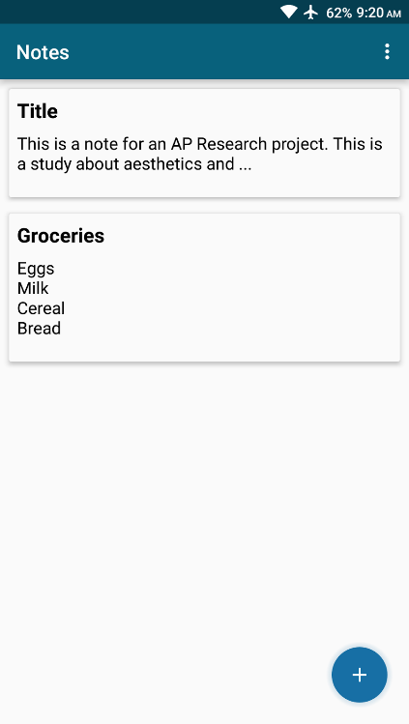
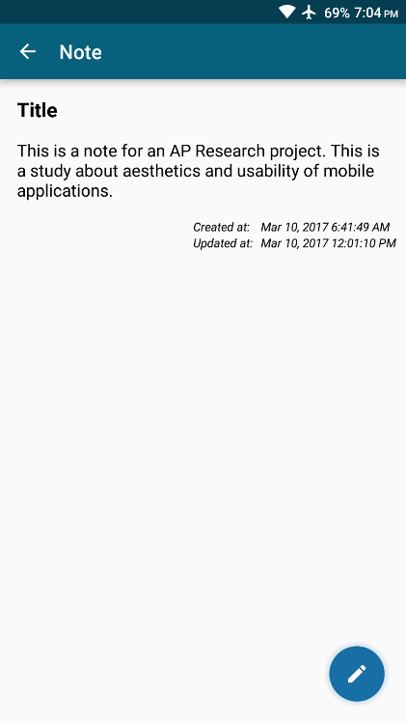
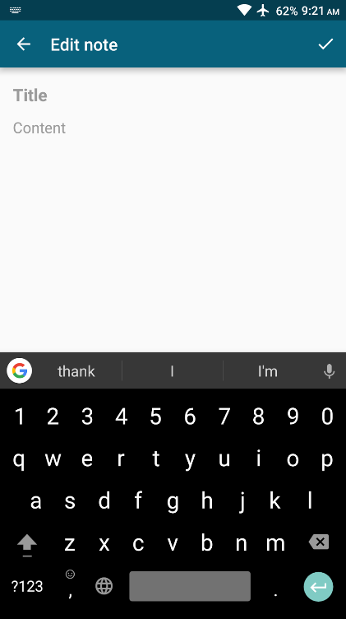
Aesthetic Application
3
Notes:
The mobile application used was a simple note-taking application with a main first screen containing a preview of previously-taken notes, a second screen containing the full text and additional information of one note, and a third screen containing an editable title and content. In the main screen, a circular button in the lower right corner allows the addition of more notes by redirecting to an empty third screen. In the second screen containing the title in the top and the text of the note in the middle, the circular button in the lower right corner redirects to the third screen as well but filled with the text of notes, all of which are editable when clicked. To save a note, the button on the upper right corner has to be pressed.

Slide 12

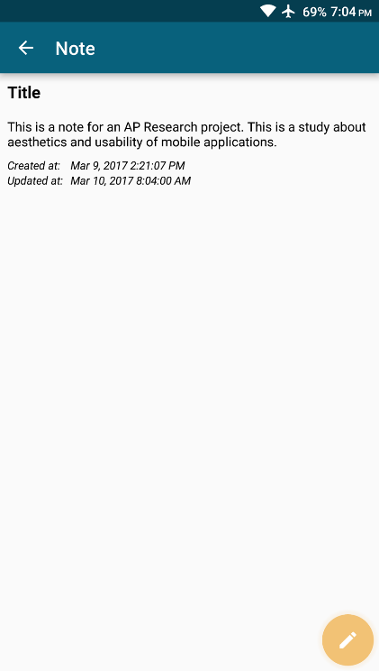
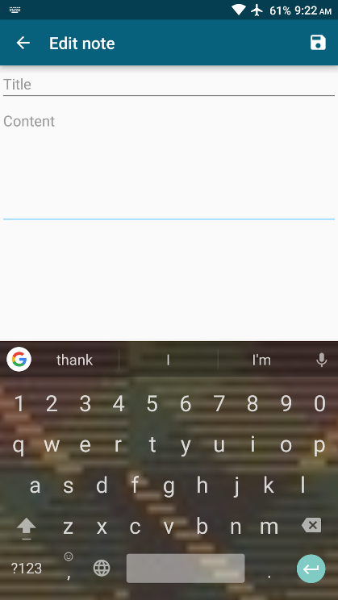
Unaesthetic Application
3
Notes:
As can be seen, the aesthetic differences are pretty minor, with most of the changes have been made in layout and symmetry as well as margins and paddings (generally speaking, spacing) of elements on the screen. The text sizes and the shapes of the cards containing the notes on the main screen was also manipulated. The color of the circular buttons were also changed in the aesthetically displeasing application to a brown color that doesn’t match the blue theme. Different themes were also used for the keyboard (Gboard by Google), with the aesthetically unappealing application having a low-resolution, vague fabric pattern as the background while the aesthetically pleasing application having a simple black color. The reason aesthetics was not manipulated too much was because major elements of aesthetics can overlap with usability (e.g. an aesthetically displeasing color combination between the background color and the font might lower the readability and therefore the usability of the application).
The applications were created using Android Studio, Google’s official IDE (Integrated Development Environment) for Android. The core functionality of the applications were based on the open-source software Material Notes by Daniel Pedraza-Arcega found in Github and used under the Apache License, Version 2.0. Most of the alterations were made on the files containing the layout and User Interface information, called XML (Extensible Markup Language) files. Both of the applications were run on the OnePlus X (made by the smartphone company OnePlus) without any changes in the hardware of the phone. Since the aesthetics of the physical aspect of the phone was constant and the design of the OnePlus X is not very conspicuous, the only notable aesthetics was of the software itself.

Slide 13
Procedure
Surveyed one at a time
Randomly assigned application
Only look at the application and rate the attractiveness of the design and how usable the application seemed on a seven-point Likert scale
Interact with the application & answer same questions
Change application to alternate version & answer same questions

Slide 14
Results
For Appealing application aesthetics rating was 4.43 while usability rating was 6.19 before interaction
After interaction, average aesthetics rating rose to 4.6 while average rating for usability slightly fell to 5.9
The average rating for aesthetics and usability after interaction with the aesthetically unappealing application shortly after was 4.55 and 5.9.

Slide 16
Results
For the Unappealing application average rating for aesthetics was 4.5 while usability rating was 6.14 before interaction
After interaction, average aesthetics rating rose to 5.07 while average rating for usability stayed at 6.14.
Average rating for aesthetics and usability after interaction with the aesthetically unappealing application shortly after was 5.36 and 6.43.

Slide 18
Discussion
People expect the beautiful to be useful as well.
- Aesthetics can affect the expectations towards usability
Another possible conclusion is aesthetics can serve as a supplement but not a detriment to functionality and usability.
- Actual usability is basis for perceived usability and it cannot go below actual usability
- Aesthetics can only build on top of actual usability to add up to perceived usability

Slide 19
Discussion
The limitations of time, survey numbers, and survey samples should be taken into consideration
For further research, the variable of actual usability as well might get more interesting results

Slide 20
References
Soegaard, M., & Dam, R. F. (2013). Encyclopedia of Human-Computer Interaction. Interaction Design Foundation.
ISO 9241-11:1998: Ergonomic, Part 11: Guidance on usability. International Organisation for Standardisation, Geneva, Switzerland.
Sonderegger, A., & Sauer, J. (2010). The influence of design aesthetics in usability testing: Effects on user performance and perceived usability. Applied Ergonomics, 41(3), 403-410. doi:10.1016/j.apergo.2009.09.002
Sauer, J., & Sonderegger, A. (2011). The influence of product aesthetics and user state in usability testing. Behaviour & Information Technology, 30(6), 787-796. doi:10.1080/0144929X.2010.503352
Tuch, A. N., Roth, S. P., Hornbæk, K., Opwis, K., & Bargas-Avila, J. A. (2012). Is beautiful really usable? Toward understanding the relation between usability, aesthetics, and affect in HCI. Computers In Human Behavior, 28(5), 1596-1607. doi:10.1016/j.chb.2012.03.024

